Slide 1
Shopper Profile Report
Publication date: | August 2020
Next publication: | August 2021

Slide 2
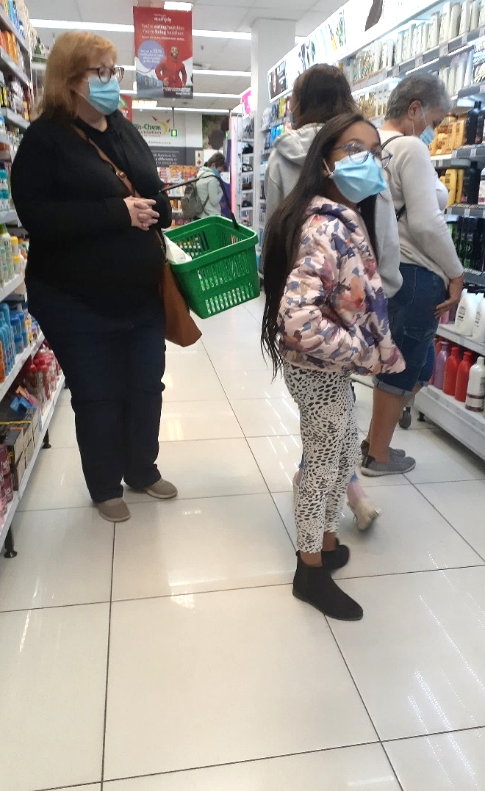
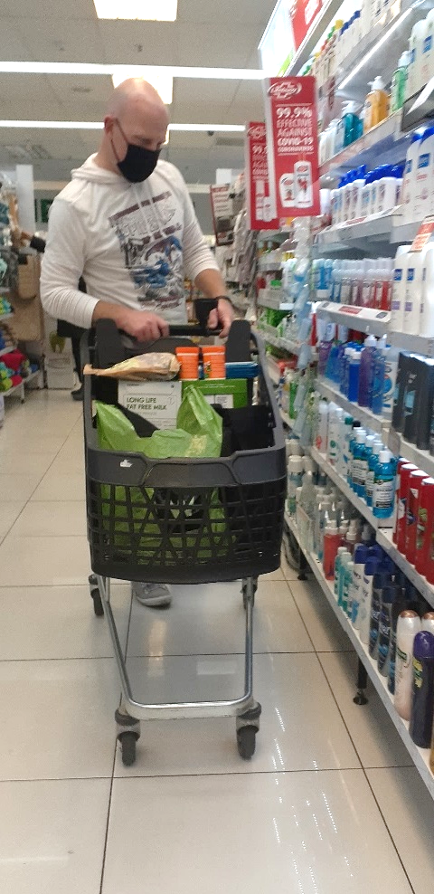
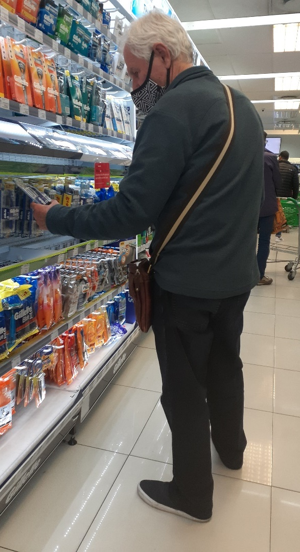
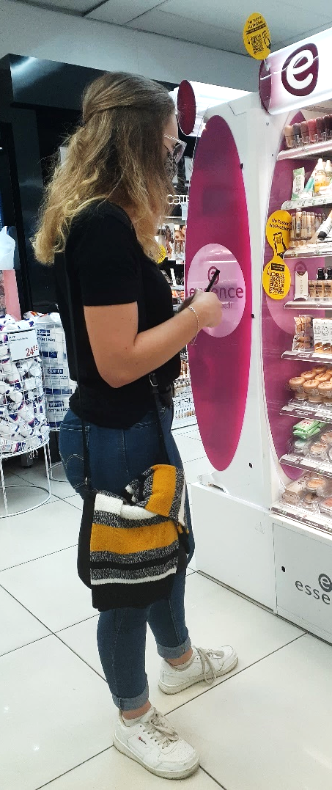
Shopper Marketing at Retail
Shopper Profile
The majority of the shoppers are from upper-end income groups
The Dis-Chem customer is typically female, shopping for herself or her family, although men represent a growing customer segment
The youth market is targeted to join the shopper loyalty programme: Over 30% of new Dis-Chem Benefits loyalty members are under the age of 30 years

Slide 3
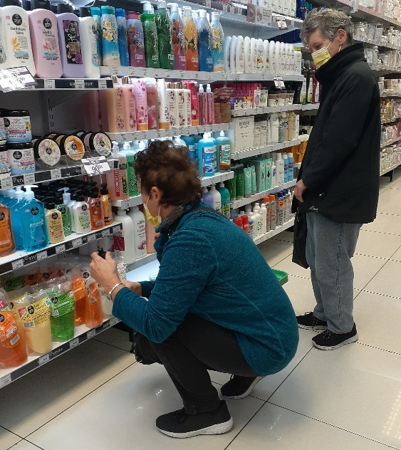
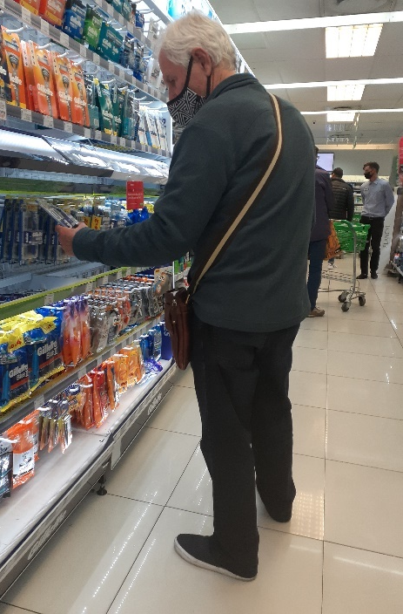
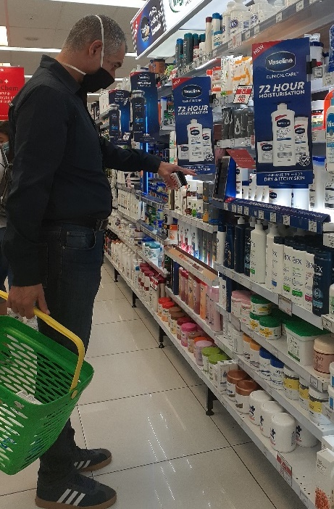
What’s going on in store?
Shopping Missions and Shopper Behaviour
Family Shopping
Parents and children are frequently seen shopping together
Children are taking part in product selection, even though fewer children have been observed in store since the COVID-19 pandemic
Impulse purchases frequently happen at till-point ‘temptation aisle’
Individuals are seen spending time selecting products
Product Comparisons
Labels are scrutinised for comparison of product features and ingredients
Product formats are compared, with consumers wanting to understand benefits of the respective formats
Consumers often compare price per unit and in many cases, product selection is made based on price per daily dose or single unit
New products are inspected with great interest
Basket and Trolley Shopping
Despite this being a pharmacy environment, most customers shop with baskets or trolleys within multiple product categories
Predominantly shopping baskets with multiple product categories
Multiple units are purchased due to value promotions, such as ‘2+1’
The Dis-Chem environment is ideal for on-shelf point of sale that supports consumer education, or helping to guide consumers to make their product selection
Because of the complexity of the categories of health and nutrition, shoppers spend time in comparing product options, based on product composition and price, sometimes calculating cost per daily application

Slide 4
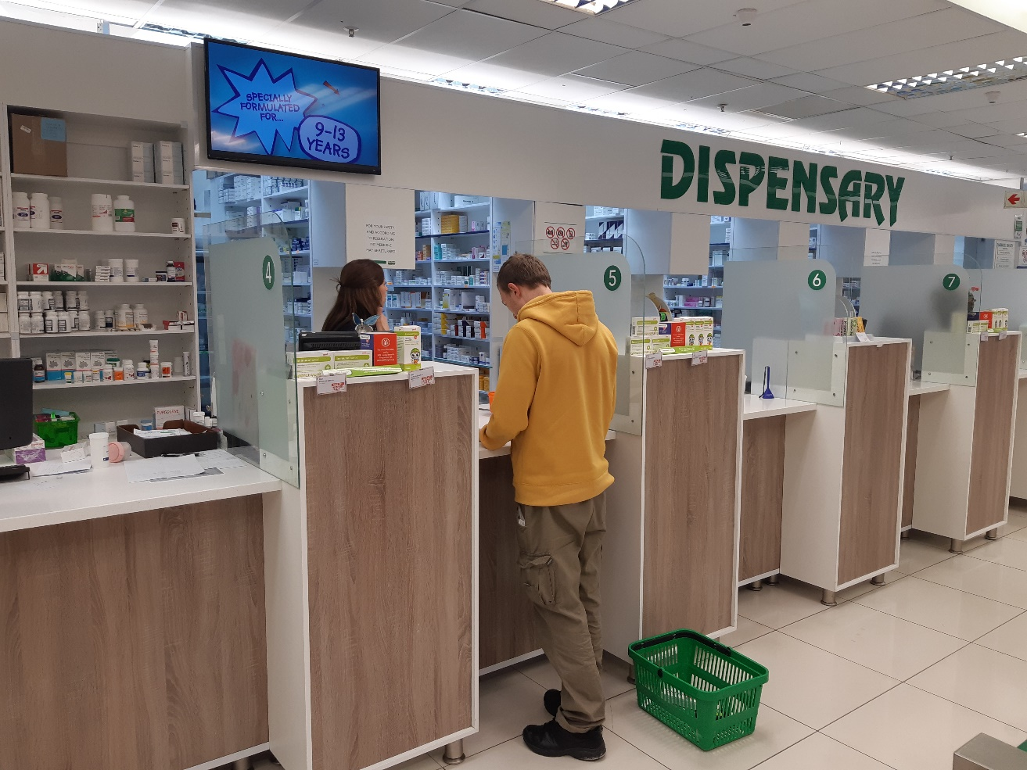
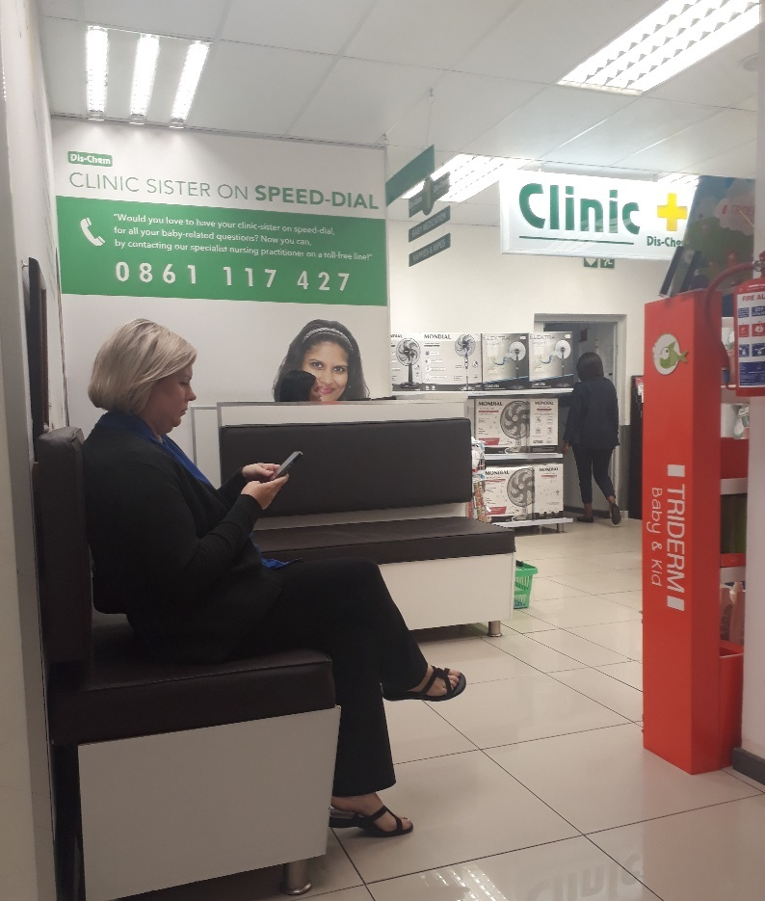
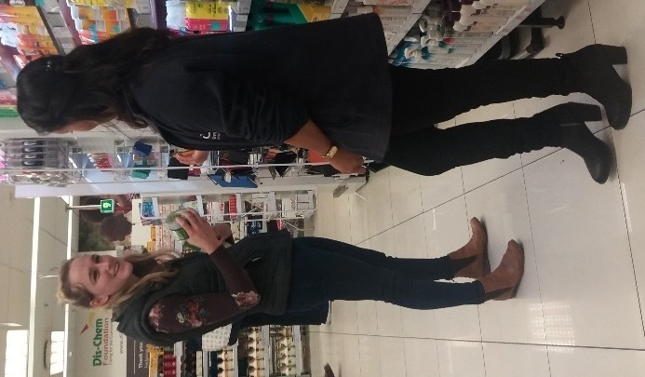
What’s Going on in Store?
Customer Service
Dis-Chem personnel are well-trained and offer a friendly and knowledgeable service
Each section is manned by front-shop personnel that regularly engage with shoppers
The dispensary and self medication sections are well staffed, preventing long queues during busy trading hours
The healthcare clinic is managed by professional nursing practitioners
Beauty clinics offer services by trained professionals

Slide 5
Andrea Slabber | Lead Analyst
Carey Leighton | Associate Analyst

